Slide 1

Data Science Clinic
Practical experience applying Data Science and technology-based solutions
Data Science Clinic DATA 27100 and 27200
Civic & Tech Data Clinic CAPP 30300, PPHA 30581, MACS 3030

Slide 2
Outline
Introductions – Who
Logistics – How the clinic runs
Grade Breakdown
Break up into groups
First “week” Schedule
Meet and Greet
Scheduling Meetings

Slide 3
Clinic People

Slide 4








Who: Nick Ross
Jobs
Data Science Clinic Director (2022-)
Director of Backend Engineering & Data Science at The Meta (Kovaak) (2020-2022)
Assistant Professor of Data Science at USF (2014-2020)
Director of Industry/Academic Partnerships
Direct of Analytics Sega (2014-2015)
Director of User Analytics and Acquisition at TinyCo (2011-2014)
Senior Consultant Bates White (2002-2006)
Education
PhD at UCLA in Management (2012)
Masters in Economics at UC Davis (2007)
BA in Applied Math/Statistics at UC Berkeley (2002)

Slide 5




Who: Tim Hannifan
Jobs
Assistant Clinic Director, Data Science Institute (2021-present)
Data Science Fellow, Mathematica Policy Research (2019)
Data Science Consultant, The World Bank (2016-2018)
Owner, contract full stack developer, TJH Media (2013-2018)
Associate, Quantitative Rates Trading, Credit Suisse (2008-2013)
Education
MS Computational Analysis and Public Policy, UChicago (2020)
BA Economics, UChicago (2008)

Slide 6

People Organization
Each Project has an External Mentor
Each Project has an Internal Mentor
Each Project has a TA
Each Project has students
Bennett: System Administrator (if you use the cluster he might jump in to help)
Nick & Tim: Internal Mentor as well as Admins

Slide 7
Your TA
Your TA was chosen based on their knowledge and experience.
Their primary purpose is to keep the project running. They are technical resources.
TA’s will:
Take attendance during their working sessions.
Provide feedback on your communication, professionalism and coding during the sessions.
Being unprofessional, rude, condescending or behaving generally unprofessional to the TA is grounds for failing this course.

Slide 8
Your Internal Mentor
Your clinic mentor was chosen based on the mentor’s skillset match to the project requirements.
Your mentor provides general project oversight and is a technical resource for the team.

Slide 9
Your External Partners
Clinic students gain experience working directly with the external mentor during the quarter.
The external partner is the domain expert for the project providing background and guidance in the application of data science to the domain.
Some partners may require NDAs, background checks or additional training specific to that organization.
Do not share details about your project or data with anyone outside of your project team, your mentor, clinic staff, and TAs.
You will need to come up to speed on the technologies they are using. Part of this process is figuring it out.

Slide 10
Logistics

Slide 11

Logistics of Clinic
Week 1-2: Domain and Technical Ramp-Up
Access, Data and Problem Statement
Setting up meeting times
Weeks 2-8: Iterative Project Development
Expected to work 10-12 (UG), 15 (G) hours per week
Writing code, doing analysis, etc.
Weeks 9-10: Documentation, Production Planning, and Video
Document all progress and approaches for future teams
Transition codebase to be ready for production
Final Deliverables:
10 - 12 minute video presenting your work
One-pager and Email
Possible Others…

Slide 12
Weekly Logistics
Everything is conditioned off of your weekly mentor meeting times
Meeting times are set by discussion with your TA and your Mentor
This is done the first week of the course via Org Report.
Each week you will be required to:
Attend the two TA sessions (in-person)
Attend the mentor meeting (possibly in-person)
Fill out your Weekly Planning Report (due midnight day of mentor meeting)
Fill out your Weekly Progress Report (due midnight before mentor meeting)

Slide 13
Mentor Meetings
Every mentor runs their mentorship differently, but some things for everyone to keep in mind:
Mentors are here to help
Mentors will report back on any issues
Show up ready to discuss the project for your weekly meeting
No new issues should be raised in your weekly meetings. Slack is the place to report issues as they arise.
Mentor meetings may be in person or remote at the discretion of the mentor

Slide 14
TA Sessions
TA Sessions are two, in-person, hour-long sessions per week.
Attendance is taken.
These are working sessions to diagnose issues, etc.
The primary way that you will interact with the TA.
Location will be in Ryerson Annex and will be given to you over slack at the start of week #2.

Slide 15
Weekly Logistics
Assume that your TA sessions are Mon and Fri and your Mentor meeting is Wed
Weekly Schedule | Monday | Tuesday | Wednesday | Thursday | Friday
Meeting | TA Session (in-person) |  | Mentor Meeting |  | TA Session (in-person)
 | TA takes attendance | Weekly Progress Report due midnight (Graded) | Weekly Planning Report due midnight (Graded) |  | TA takes attendance

Slide 16
Weekly Feedback / Planning / Progress
Each week you will be graded (individually) on:
Planning report:
Did you describe the tasks that were supposed to do?
Progress report:
Did you complete the tasks outlined?
Attendance at working sessions

Slide 17
Planning and Progress
The progress report is a weekly assessment of the work you did.
Since you wrote your planning document it is important to be complete and specific around the tasks.
If there is a misunderstanding about “what” was supposed to be completed it is on you… you wrote the task description!
If you:
Procrastinate
Get stuck
Do the bare minimum to complete the task
Complain that a task wasn’t clear
Remember – it was your task description!
You will get docked points.

Slide 18
In general…
This is not a p-set where you simply complete the task the night before
This is iterative analysis:
You will get stuck
Waiting until the night before a report is due is a recipe for failure and poor grades
Even if a task seems relatively straightforward:
No one has done it before, on this data set, using this code.
We (mentors) don’t know exactly what will happen.
We have very little sympathy for getting stuck at the last minute

Slide 19

Communication
Canvas
Grade updates
All graded submissions
Major course announcements
Github
Code submission/review
Clinic Repo:
https://github.com/dsi-clinic/the-clinic
Slack
Quick access to mentors and course staff
Questions here instead of in meetings
Keep conversation in team channel for visibility
Use threads
Notes:
Emphasize that git and slack are the main communication channels.

Slide 20
Data and Communication
Your default position should be that:
All data used
All code produced
All conversations
Are confidential.
If your laptop is stolen or compromised in some way
Tell us ASAP.
Make sure that multi-factor authentication is set to on for your github account.
Obvious question: What if I want to talk about this on my resume or in an interview?
There is a doc on the clinic github page that has some good rules of thumb about this
If you have specific questions ask Tim/Nick
SLACK with Nick/Tim:
Nick and Tim are in every slack channel, but we don’t grade off of them for content. Obviously is someone is being unprofessional, etc. that will affect their grade.
There are some administrative / pedagogy reasons we need to be in each channel, but we aren’t monitoring them day-to-day.
You can ignore us in the channel or call out (by tagging) if you are having issues.

Slide 21
Grading and Assessment

Slide 22
Grade Break down
10% Peer Evaluation
20% Weekly Reports
5% Surveys, initial org reports, computer setup
10% Professionalism
15% Mid Quarter presentation
40% Final Deliverables
“BIG” Deliverables:
Mid-Quarter Presentation
Final Deliverables:
Video Presentation
One Pager
Client Deliverables
Technical Deliverable
All grades are posted and all assignments are to be submitted via Canvas.
You should have received an invite to the DATA 27100 Canvas Page
Where can I find information about grading standards, rubrics, etc.?
On the github clinic page!

Slide 23
First few days

Slide 24
Week #1 Logistics
Org Report is due FRIDAY Night at midnight.
Submit as a group via Canvas
You need to coordinate with your mentor and TA.
If you have any issues getting hold of someone, please let me know ASAP.
Thursday: Technical Demonstration & Verification
Your computer needs to be set up (see Computer setup assignment on Canvas) before class on Tuesday.
If you are returning to the same project, no need to attend.
Notes:
Emphasize that git and slack are the main communication channels.

Slide 25
Week #2 Logistics
You will get your TA meeting times and locations
1st Mentor Meeting date:
Week #1 Progress Report due the night before.
Template will be provided – basically “did you get your computer verified”
Week #2 Planning Report due mentor meeting night.
Notes:
Emphasize that git and slack are the main communication channels.

Slide 26
External Mentor Meetings
When you meet with your external mentors you need to fill out a mentor meeting notes template
This will help you stay organized and identify specific action items required.
You can find more information about this in the github repo.
Note that this is graded as a group, so make sure that you have a designated note-taker.
Notes:
Emphasize that git and slack are the main communication channels.

Slide 27
Break OUT

Slide 28
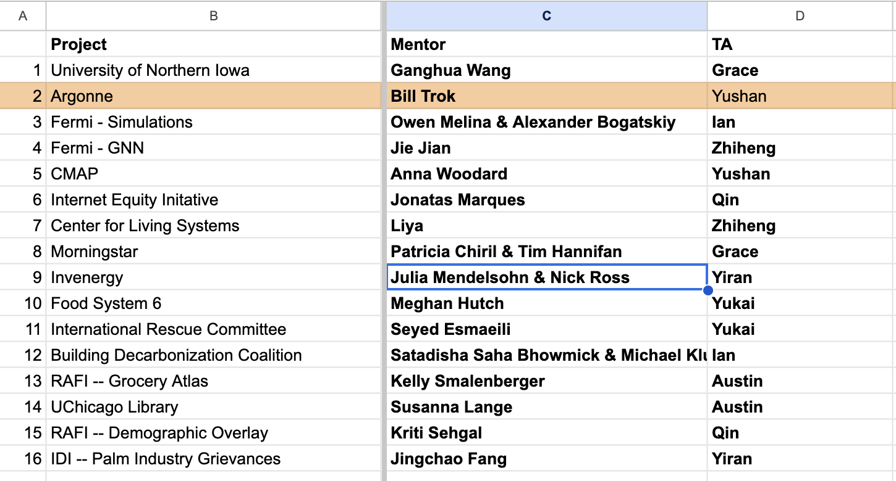
Mentor Information

Slide 29

Breakout: Coordinating with your Team
Meet your team:
Name / Program / Year
Identify your mentor(s) / TA in Slack
Weekly team meeting time
Start filling out Org Report
If you ping someone and do not hear by Wednesday at 5pm, please slack me directly.
Verify Github, Canvas and Slack
Begin Installing Software for Thursday

Slide 30
The End

